Slide 1
Basics of Quantum Computing Non CIE Component Quantum Computing - MCS22
Department of Computer Science and Engineering
NAME:C.SATEESH
USN: 1MS21SCS05

Slide 2
Define quantum computing
1.Computer technology has evolved so immensely over the years.
2.Currently, the trend leans towards quantum computing.
3.This computing approach can help humans solve various complex problems.
4.A conceptual understanding about this technology is necessary even at a basic level.

Slide 3
Define quantum computing
5.It refers to computation that uses the principles of quantum physics. Quantum physics deals with the smallest physical units that exist within the human realm. The common principles applied in the computing system are the superposition, entanglement, and quantum interference.
6.The computing system is done by quantum computer. A conventional computer works with bits which can be 0 or 1 (a definite number). However, this computing method works with qubits instead. Instead of dealing with one definite problem at a time, it computes numerous probabilities at once.

Slide 4
D Distinguish quantum computing and classical computing
Classical Computer | Quantum Computer
It is large scale integrated multi-purpose computer. | It is high speed parallel computer based on quantum mechanics.
Information storage is bit based on voltage or charge etc. | Information storage is Quantum bit based on direction of an electron spin.
Information processing is carried out by logic gates e.g. NOT, AND, OR etc. | Information processing is carried out by Quantum logic gates.

Slide 5
Distinguish quantum computing and classical c0mputing
Circuit behaviour is governed by classical physics. | Circuit behaviour is governed explicitly by quantum mechanics.
Classical computers use binary codes i.e. bits 0 or 1 to represent information. | Quantum computers use Qubits i.e. 0, 1 and both of them simultaneously to run machines faster.
Operations are defined by Boolean Algebra. | Operations are defined by linear algebra over Hilbert Space and can be represented by unitary matrices with complex elements.
No restrictions exist on copying or measuring signals | Severe restrictions exist on copying and measuring signals

Slide 6
Applications and advantages of quantum computing
How to apply this computing method in the human realm? Here are some problems that may benefit from quantum solutions:
Simulation The quantum computer is able to crunch enormous data, which includes molecular activity in one being. This ability enables the computer to create very accurate simulations of real life events, such as photosynthesis.
Optimization Instead of calculating a problem at a time, this computing approach solves various probabilities. Through such a system, you can see how each option can provide the most advantages. Thus, you can optimize that option.

Slide 7
Applications and advantages of quantum computing
Cryptography Cryptography involves difficult mathematical problems such as discrete algorithms and integer factorization. These problems take a long time to solve. However, a computer with quantum principles can do it quickly.
Machine learning This concept is difficult to apply as it takes so much time and financial resources to do it. The computing system can help speed up the process significantly.

Slide 8
Applications and advantages of quantum computing
Data search Although the conventional computer has evolved so much over the past decades, data search still takes too long sometimes. Quantum principles are capable of speeding up this data search process, especially if the search is unstructured.

Slide 9
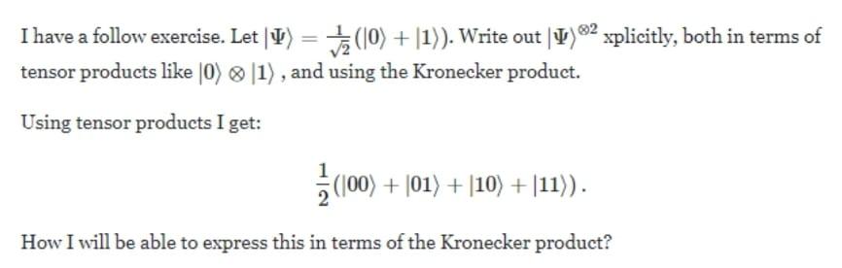
problem

Slide 10
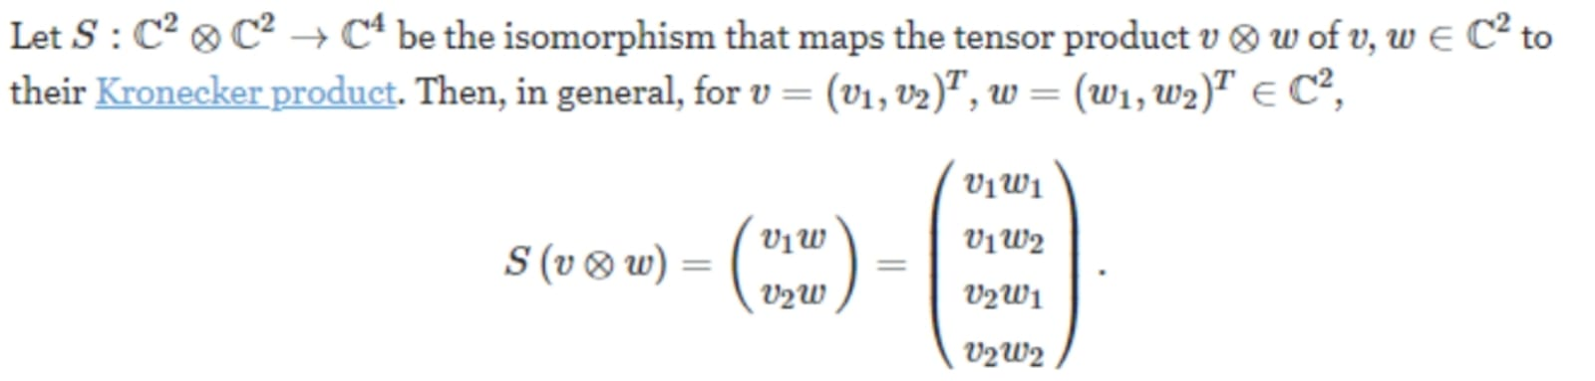

Slide 11
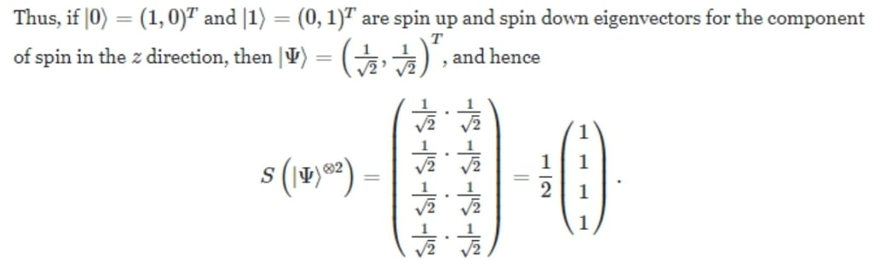

Slide 12
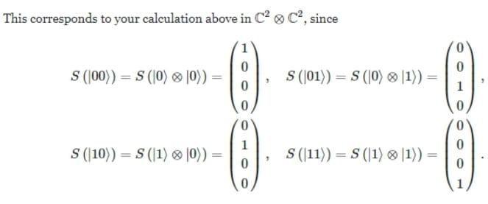

Slide 13
Thank You

